Slide 1
MicroCART Project Structure

Slide 2
MicroCART has three areas of development
The quadcopter
The groundstation
The controls model
This presentation will primarily focus on the last two since we are using Crazyflie’s as the quadcopter.

Slide 3
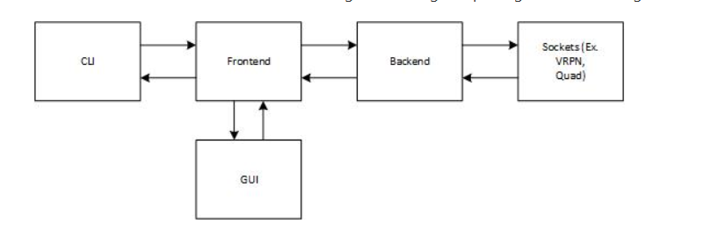
Groundstation Components
CLI and GUI are the same, except the GUI shows the control graph and provides extra navigational help.
Frontend communicates with the backend via a socket.
Backend has connections and passes data between the VRPN (camera system), the quadcopter, and the GUI/CLI.

Slide 4
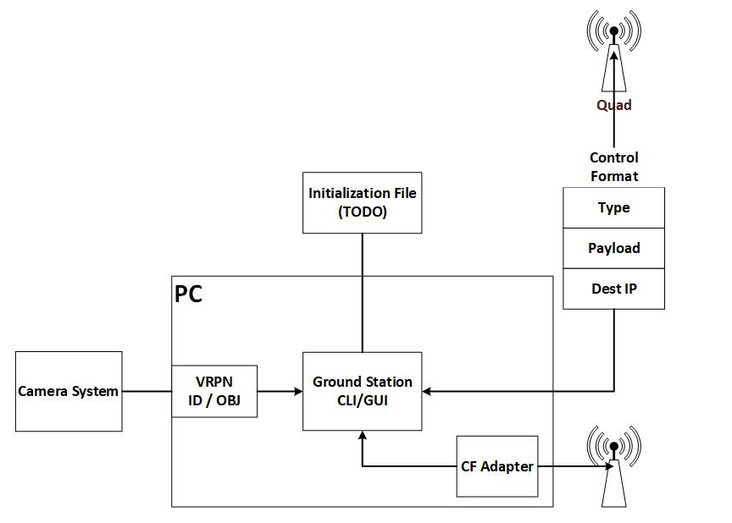
Sample Connection
Initialization File and CF Adapter were only proposed changes so they are not completely usable yet.
Camera system feeds to VRPN (https://github.com/vrpn/vrpn)
Packets between ground station and old quadcopter are custom packets sent over WiFi
Obvious interest is the Crazyflie adapter. If that can be completed, the old ground station can be used and expanded upon.

Slide 5
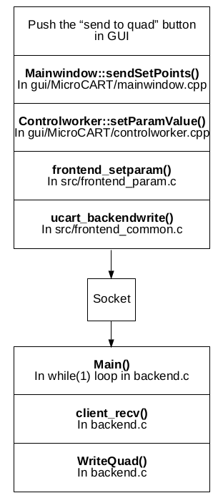
Groundstation commands and their flow through the Groundstation
Commands: ./getsource, ./setsource, ./getparam, ./setparam, ./getoutput, ./getnode, ./addnode
GUI command flow to the right

Slide 6
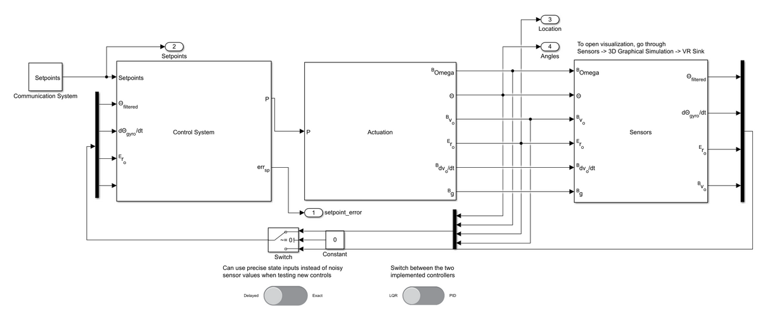
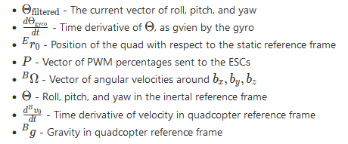
Control Model
Three primary components: Control System, Actuation, Sensors
Input are setpoints which contain 4 values: x,y,z, and yaw

Slide 7
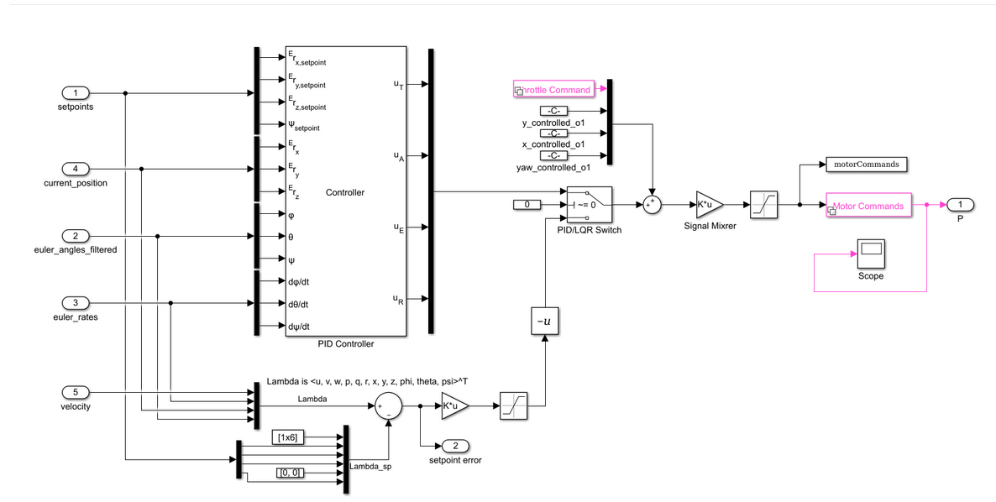
Control System

Slide 8
Two Different Controllers
PID: contains the PIDs for each part of the setpoint, and outputs control values to the signal mixer. These inputs are thrust, aileron, throttle, and rudder. The controller has a set of four nested PIDs, each one dedicated to one of the output variables
LQR: State-feedback controller, which generates output based on state estimation directly from sensors. More information behind the design of the controller can be found here: https://git.ece.iastate.edu/danc/MicroCART/-/blob/master/controls/documentation/LQR_Design.md

Slide 9
Rest of Control System
The controller output is then mixed with the equilibrium input, which for the quadcopters is hovering.
The output of that is then passed to the signal mixer.
Signal Mixer is a 4x4 matrix that is multiplied with the vector (uT uA uE uR) to produce a ector of PWM commands for the motor

Slide 10
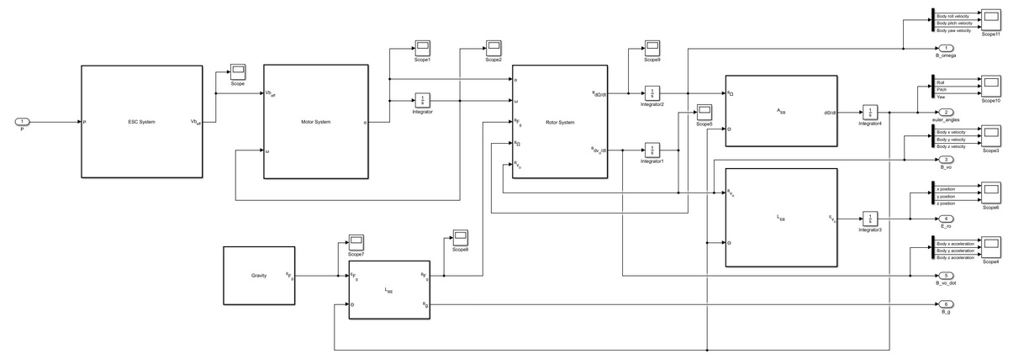
Actuation

Slide 11
Each Major System Explained
ESC System: input is the vector of PWM percents, scales them to an allowed duty cycles, and calculates the battery voltage given to each motor.
Motor System: input is the vector of effective voltages and a vector of current angular velocities for each motor, this system will compute the angular acceleration for each.
Rotor System: Computes total force and torque acting on the quadcopter. The force consists of thrust created by the rotors and gravity. The torque consists of components caused by drag, changes in rotor angular momentum, and thrusts at a distance from the center of mass. The system then uses these to output the linear and angular accelerations in the quadcopter body frame.

Slide 12
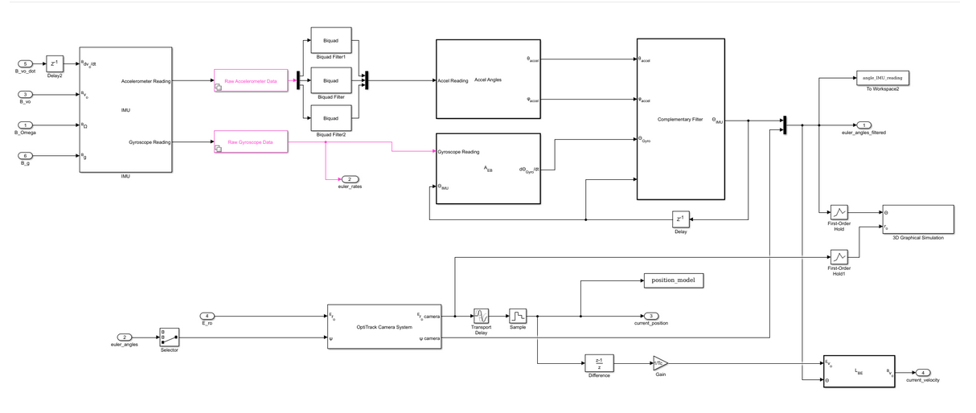
Sensors
The two major sensors are the accelerometer and Gyroscope

Slide 13
Major Takeaways
Getting the CrazyFlie adapter to work would be a huge benefit as this would allow us to use the existing groundstation with the crazyflie’s which means we can expand upon the groundstation immediately and it can benefit both the crazyflie’s and future quadcopters made for MicroCART
The old microCART quadcopter used both an accelerometer and a gyroscope which is what the crazyflie’s also have. Much of the control system can be used with the crazyflie

